Slide 1
Cypress
NextGen Automation Framework

Slide 2
Cypress Introduction
Next generation frontend automation testing tool for modern web applications
Many existing tools like, Selenium WebDriver, Protractor, WebDriverIO
Why Cypress?
How Cypress is different from other tools
Cypress addresses the key pain points developers and QA engineers face when testing modern applications

Slide 3
Cypress Features
Automatic Waiting
Debuggability
Supports multiple types of testing
Time Travel
Network Traffic Control
Smart Orchestration
Flake Detection
https://docs.cypress.io/guides/overview/why-cypress

Slide 4

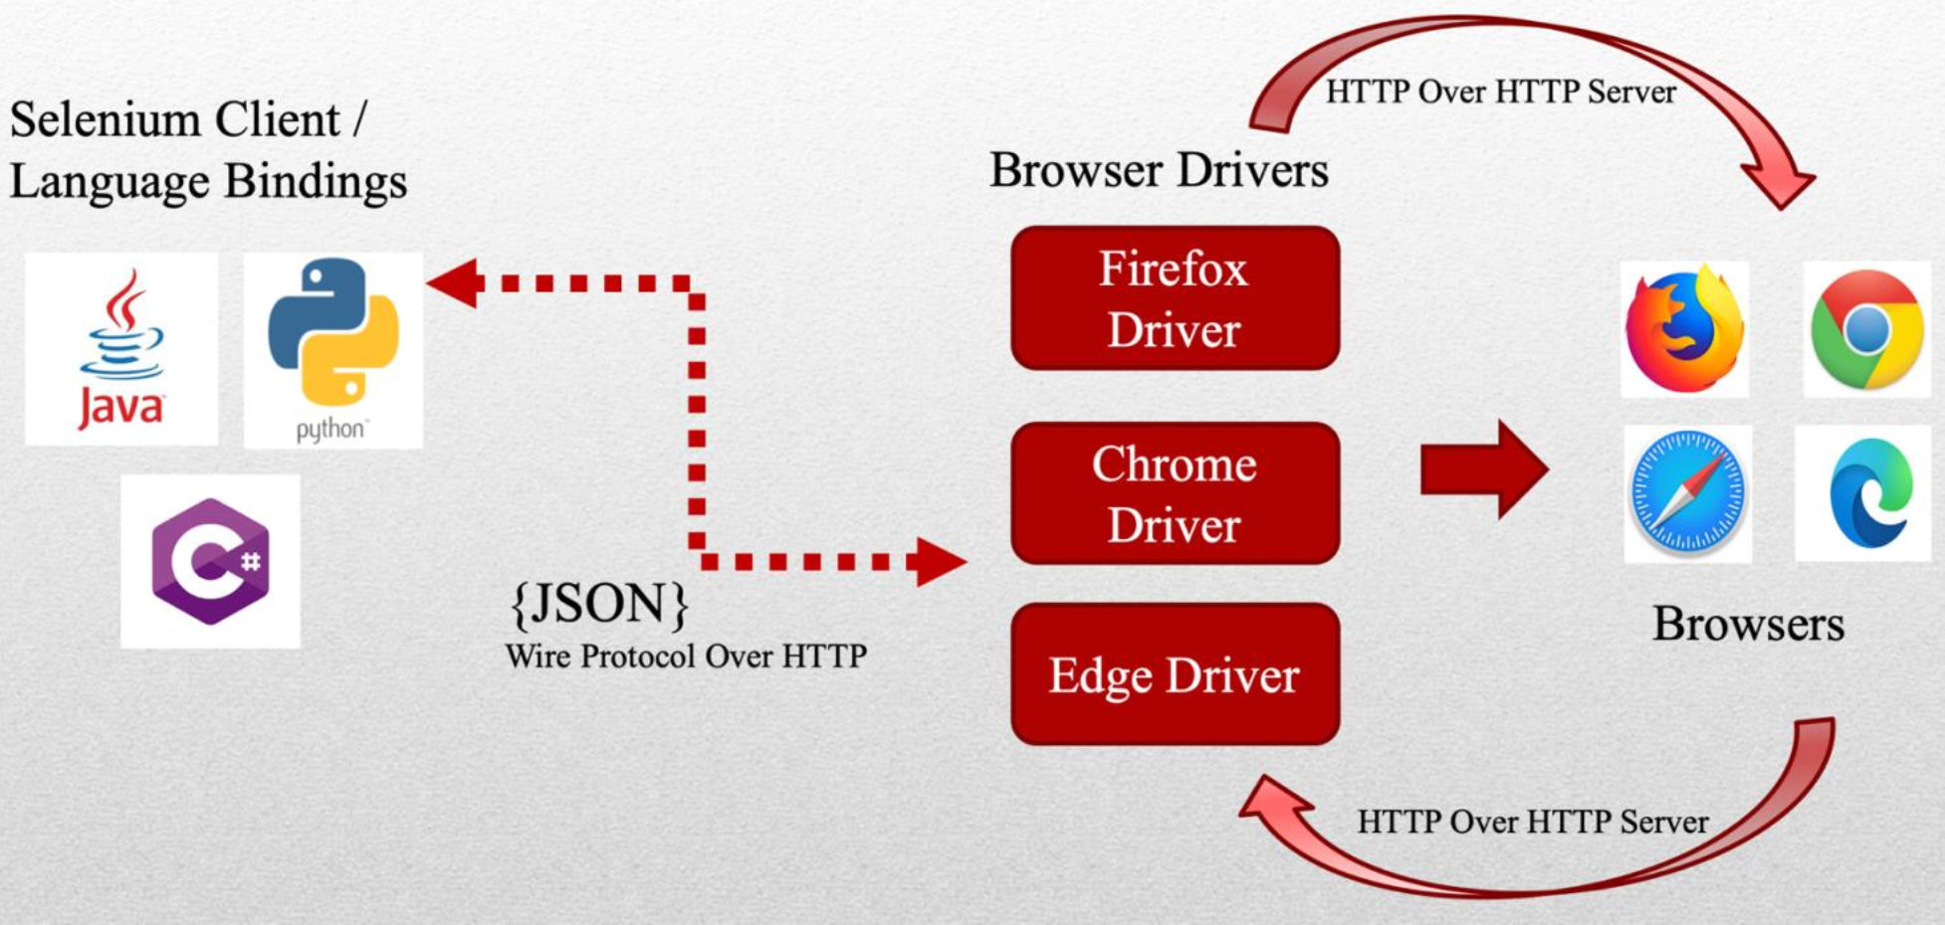
WebDriver Architecture

Slide 5
Cypress Architecture
Browser
Using same domain with proxy
NodeJS
Cypress
Tests
(iframe)
App (iframe)
DOM Local Storage
Web
OS
Proxy

Slide 6
Cypress vs Selenium
Pros
Complete Framework
Fast (Uses JavaScript)
More Stable
Less programming knowledge
Test APIs
Mock APIs
Cons
IE and Safari not supported
Asynchronous
No Mobile App Automation
Single domain and single tab
Not friendly with iframes

